Slide 1
Metals Dashboards and LG M48F Supply Plan Creating Data Pipelines as Cross-Functional Tools
Chiemi Kato
December 2019

Slide 2
What is the meaning of cross functional?
denoting or relating to a system whereby people from different areas of an organization work together as a team.
Especially for someone with my professional and academic background more suited towards programming, I wanted to make sure I was making an impact in the best way possible, and to me this meant making sure the tools I was creating were accessible to use and maintain
WHAT IS THE MEANING OF DATA PIPELINE?
ee

Slide 3
Agenda
LG M48F Supply Plan
Background/Pain points
Steps/Processes/Ideas
What I created to solve problem
Outcome – What is the improvement
Final benefit (purpose I was able to gather information to create detailed SP for other teams to understand and use as tools to simulate their own ideas)
Design – was not set in stone, there was a lot of pieces that were up in the air (such as how we were to communicate updates and agreed upon strategies/methods for production/operational analysis of design changes, etc. )
Dashboards
Background/Original Challenges/Pain Points
What I did
Challenges I found along the way
How to access
Walk through of dashboards and DEMO of price scraping

Slide 4
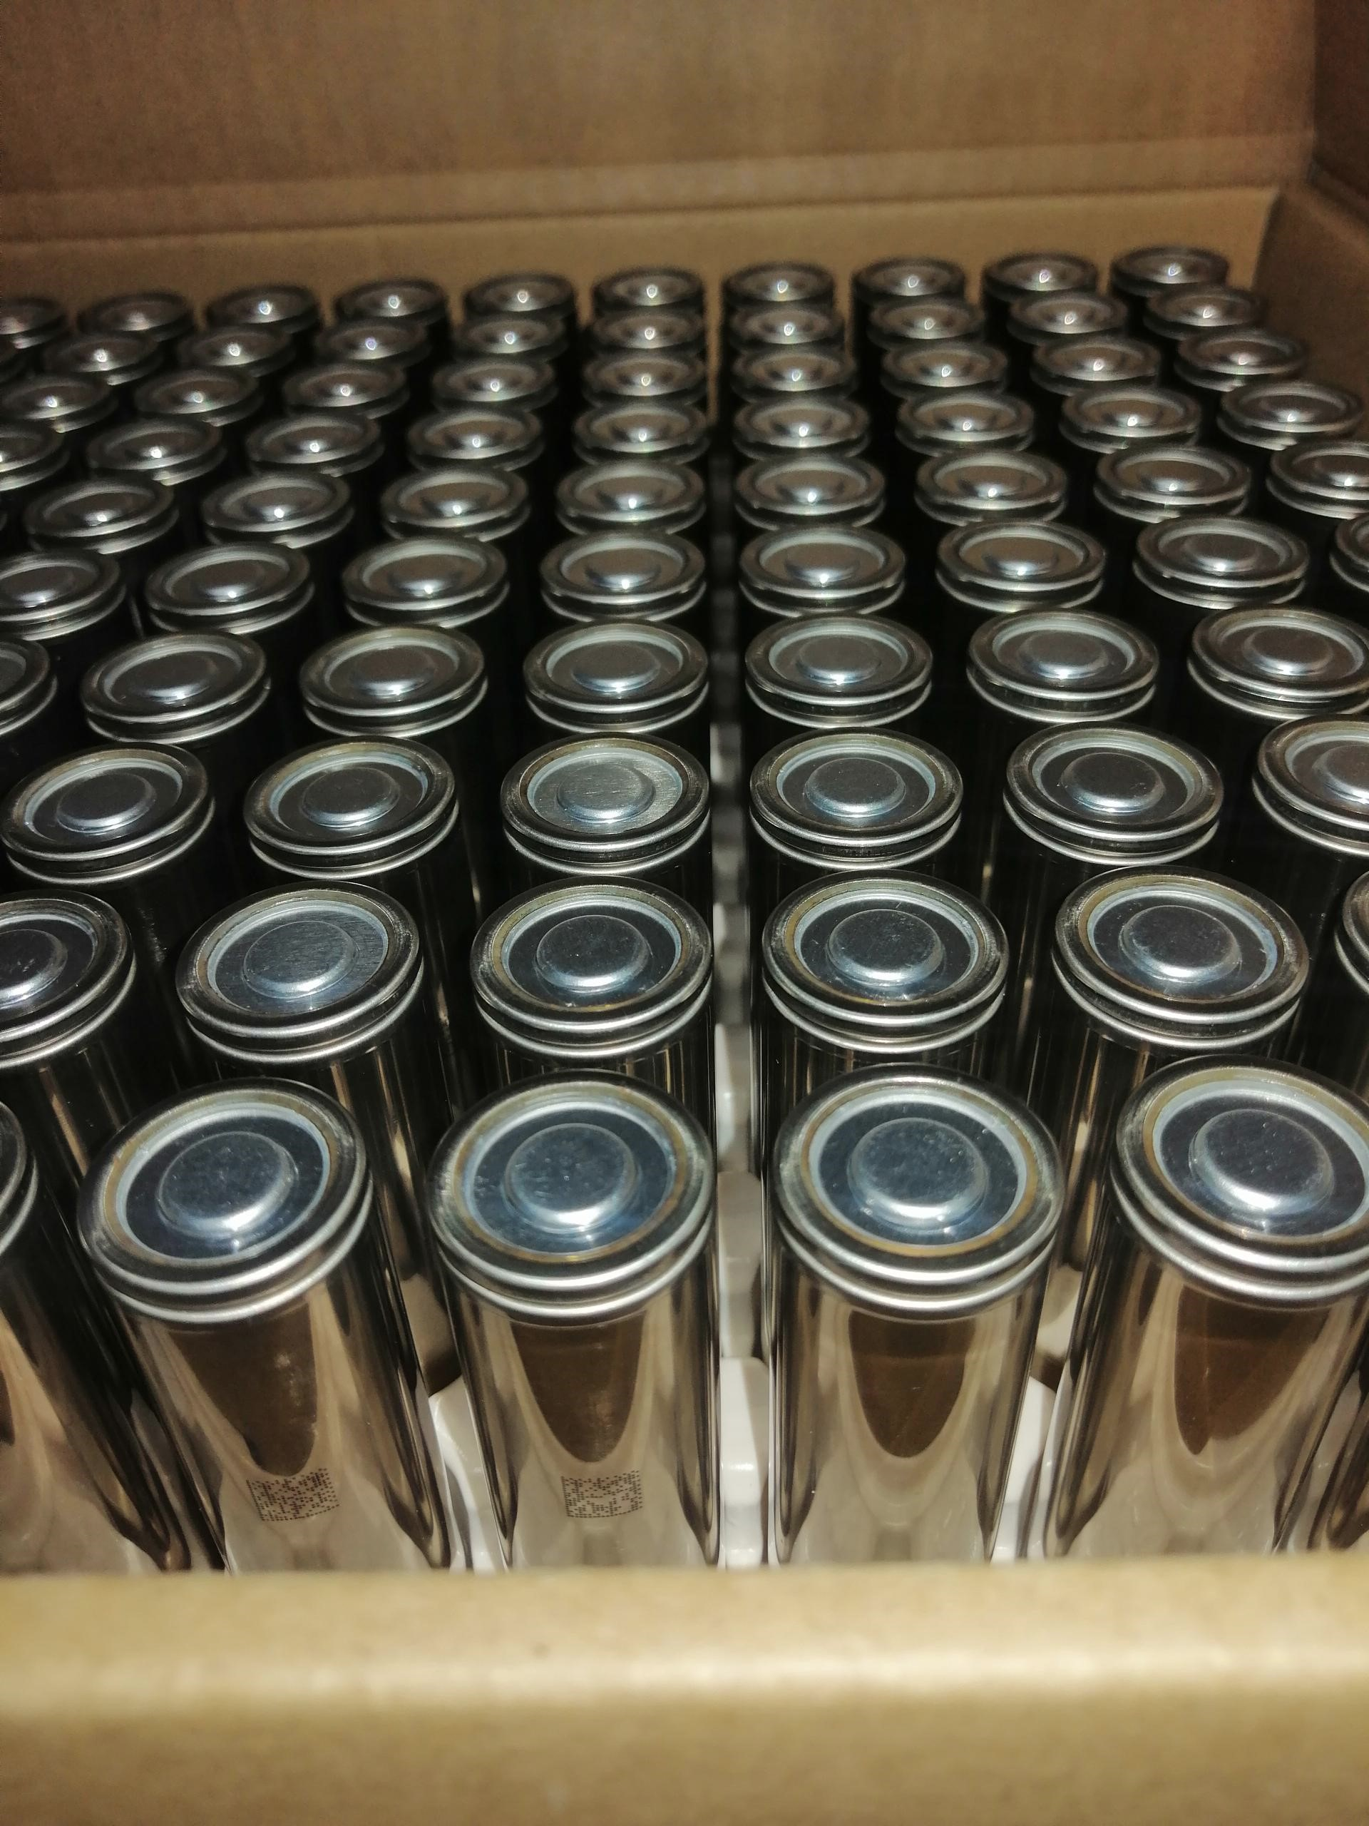
LG M48F Supply Plan Background & Challenges

Slide 5
Background & Challenges
Background: LG has been working with Tesla for around a decade on small volume battery operations like Powerwall
In late 2018 they signed a deal with Tesla for their first mass production assembly of battery products at Gigafactory 3
When I joined the project in September, I was assigned to work on the M48F supply ramp up plan there were many things to be improved -- really was no framework for how we were to communicate and collaborate with LG on a PRODUCTION LEVEL
At that time, we were provided with limited monthly information about cell supply and component capacity
CHALLENGE: There was no framework for communication or operational analysis between Tesla and LG and we weren’t exactly sure how our vehicle production and sale would be impacted by LG’s production capacity

Slide 6
2. What I created to solve problem
Toggles to identify how supply will be impacted by design changes
Setup framework for LG to be able to provide more granular weekly production data and by assembly line
Integrated/consolidated information from finance to provide different demand scenarios
Agreed with LG on a calendar formatting system and to pass the file back and forth to continuously improve the tool
LG did the rest and I worked with them to improve and fix any errors from the new system

Slide 7
3. Outcome – What is the improvement -DEMO
Show toggles…and walk through the PIPELINE of how information gets filtered into SUMMARY page
How I taught myself the operations by learning from the excel file (EXAMPLES)

Slide 8
4. Final benefit
(purpose I was able to gather information to create detailed SP for other teams to understand and use as tools to simulate their own ideas)
Show final EVAL graphs which track any new changes that might have been overlooked or not communicated

Slide 10
Metals Dashboards PLACE PIC
Background/Pain points
Steps/Processes/Ideas
What I created to solve problem
Outcome – What is the improvement
Final benefit (purpose I was able to gather information to create detailed SP for other teams to understand and use as tools to simulate their own ideas)

Slide 11
Background/Pain points
Sarah had a dashboard file that came with a long list of constraints and technical flaws/workarounds
She asked me to transition the dashboard to something that could automatically update to create more robust data pipeline tools
PROS:
A lot of data transformations and calculations were already done and there was a general format of the graphs that was already created
CONS:
I had to go back to the source files to restructure the way that the data was being stored. If there were errors in the data, I had to find most of them myself/parse through previous mistakes and a lot of new data and notes from previous intern

Slide 12
2. What I created to solve problem
- Reorganized the source files to be consolidated into only a few excel sheets and then converted data tables in to a SQL database which can be easily updated with replaced information without disrupting the visualizations
Used python to automate a lot of the data calculations and transformations
Challenges: SHARING features

Slide 13
3. Outcome – What is the improvement
DEMO

Slide 14
5. Final benefit
A lot more room for growth by allowing for enhanced sharing capacities, via Power BI online and Sharepoints integration
All of the automation is done within ONeDrive cloud so I think this process can be completed by other team members as well
Easier load for Sarah!

Slide 15
NOTES:
Add more info about data pipelining + sharing capacities
More screenshots and charts?
Info about price forecasting / Process
DEMO work/steps organize

Slide 16
Forecasting PLACE PIC
Background/Pain points
Steps/Processes/Ideas
What I created to solve problem
Outcome – What is the improvement
Final benefit (purpose I was able to gather information to create detailed SP for other teams to understand and use as tools to simulate their own ideas)

Slide 17
Background/Pain points
Disclaimers/challenges
Background

Slide 18
2. What I created to solve problem
- Goal: To make a tool that is accessible to ALL
Challenges: SHARING features

Slide 19
3. Outcome – What is the improvement
DEMO of webscraping of nickel prices
DEMO

Slide 20
5. Final benefit
Nickel forecasting

Slide 21
NOTES:
Add more info about data pipelining + sharing capacities
More screenshots and charts?
Info about price forecasting / Process
DEMO work/steps organize

Slide 22
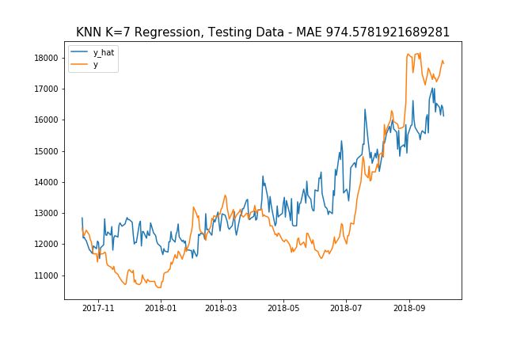
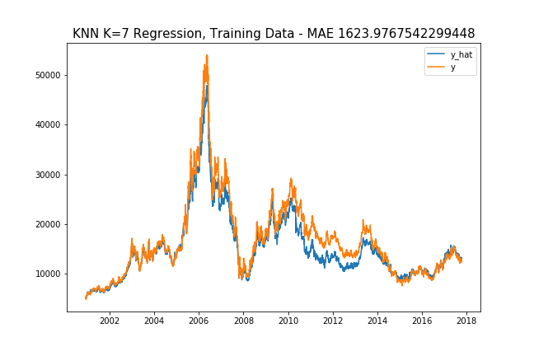
Selected Result Graphs… Below is graph of 10 lags, lag length = 4 weeks, rolling window length = 4 weeks

Slide 23
Additional / Exogenous Variables
China GDP
GDP per Capita
GDP per Capita Growth
China Overall Consumption
Consumption Expenditure
Consumption Expenditure (by GDP)
Time
Days of Month
Both
Weeks of Year
Global Nickel Production
Global Nickel Prod.
week of year, global nickel prod, consumption div gdp CHINA, no gdp!

Slide 24
MAE RESULTS (1 year gap from y Target)
Model | Time Unit | # Lags | Lag Length | Rollavg Win. | Parameters | MAE
KNN | Busi. Day | 10 | 1 month | 8 weeks | K=2 | $1199.13270
Polynomial | Busi. Day | 10 | 1 month | 8 weeks | Deg=3 | $1173.80122
Adaboost | Busi. Day | 10 | 1 month | 8 weeks | {'learning_rate': 0.0001, 'n_estimators': 150} | $1841.94740
KNN | Busi. Day | 10 | 1 month | 2 weeks | K=7 | $1253.4538
Polynomial | Busi. Day | 10 | 1 month | 2 weeks | Deg=3 | $1264.15163
Adaboost | Busi. Day | 10 | 1 month | 2 weeks | {'learning_rate': 0.0001, 'n_estimators': 50} | $1364.1369
KNN | Busi. Day | 10 | 2 week | 3 weeks | K=6 | $1045.21761
Polynomial | Busi. Day | 10 | 2 week | 3 weeks | Deg=3 | $1301.42426
Adaboost | Busi. Day | 10 | 2 week | 3 weeks | {'learning_rate': 0.0001, 'n_estimators': 50} | $1336.64916
KNN | Busi. Day | 10 | 1 month | 4 weeks | K=7 | $974.02
Polynomial | Busi. Day | 10 | 1 month | 4 weeks | Deg=3 | $1417.294
Adaboost | Busi. Day | 10 | 1 month | 4 weeks | {'learning_rate': 0.0001, 'n_estimators': 50} | $1401.205

Slide 25
Turning Time Series into Supervised Learning

Slide 26
References
TIME SERIES ANALYSIS training testing:
https://stats.stackexchange.com/questions/346907/splitting-time-series-data-into-train-test-validation-sets
About “Day Forward Chaining”
https://towardsdatascience.com/time-series-nested-cross-validation-76adba623eb9
Good KNN Explanation:
https://towardsdatascience.com/machine-learning-basics-with-the-k-nearest-neighbors-algorithm-6a6e71d01761

Slide 27
